Slide 1
POWER DRESSING
Speaker by Ibrahim Aminu

Slide 2
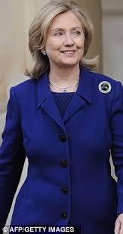
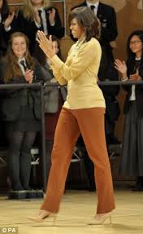
1. What is power dressing?
Power dressing is a fashion style that enables women to establish their authorities in a professional and political environment usually dominated by men.

Slide 3
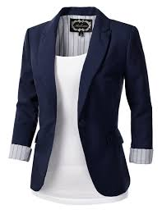
How Can I Achieve Power Dressing?
Blazers
Tailoring:

Slide 4
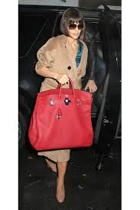
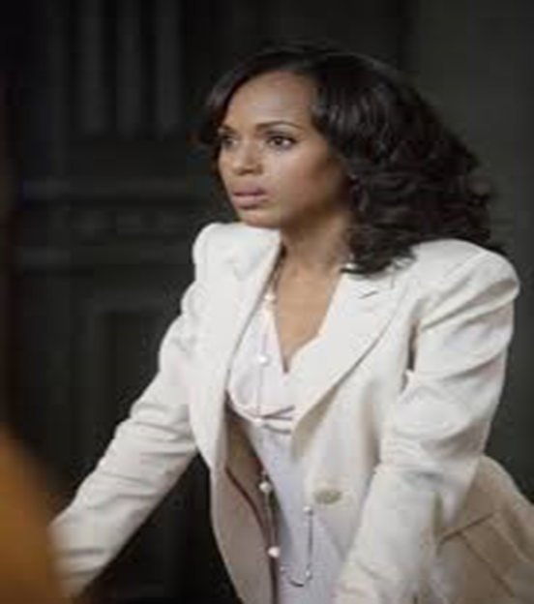
How Can I Achieve Power Dressing?
Luxe Fabrics
Accessories

Slide 5
2. How can I dress sharp whilst maintaining my own style and personality?
Seek inspiration
Write down the names of your favorite style icons and do a bit of research via internet to gather inspiration from their looks.
Consider the persona you want to present to the world: You want your style to reflect your personality, but it also has to make sense in your field of work, your overall lifestyle, the city you live in and aligned with your long-term goals.
Do you want a better job? Are you trying to make it in a particular industry? Think about adding a few sharp and appropriate professional pieces for interviews in that line of work.

Slide 6
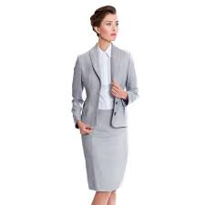
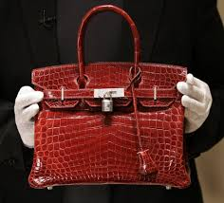
What are the do's and don’ts for professional dressing?

Slide 7
3. What are the do's and don’ts for professional dressing?
Do’s
Business suits
Skirts: the length should hit just above or below the knee or below the ankle.
Slacks: neatly pressed, nothing too tight
Blouses: Dressy styles or button-down shirts paired with a cardigan or blazers.
Dresses: worn alone, or with a suit jacket or blazer
Shoes: closed-toe, polished, scuff-free.
Jewelry: tasteful and simple, not overdone.

Slide 8
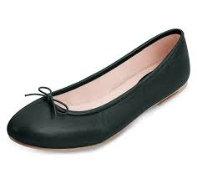
What are the do's and don’ts for professional dressing?

Slide 9
What are to do's and don’ts for professional dressing? Cont.….
Don’t
Anything too short, too revealing, too tight or too sheer.
Blouses that are sleeveless or low-cut.
Casual wears like Jeans, shorts, summer dresses.
Casual khaki pants (neutral or khaki-colored dress slacks are OK).
Open-toed or overly casual shoes (flip flops), or those with extremely high heels.

Slide 10
4. How can I make my suits and work clothes feel more feminine?
Heels: One of the simplest ways to make a pants suit look more feminine is to slip on a pair of heels, not super high, 2 inches. These instantly elevate a masculine style to a more feminine level.
Tailoring: Sometimes it's all about the cut, so look for a suit that has a great cut. Pick a pair of pants that flatter your legs, and a jacket that is tailored to hug your waist.
Bright color: You can pick one in a single color, stripes, or patterned. If you're wearing a shirt with a collar, place the collar outside the jacket for a really visible splash of color. Pastel colors work great too
Accessories: Belts, ear rings, broche.

Slide 12
5. How can I dress well for work on a budget?
Shop Smarter
Look out for trendy deals at discount places and discount season like black Friday, Christmas and end of year sales.
Also affordable brands like Pink Fleur and Emerald Mo.
You should only splurge on staple pieces: a great handbag, a good high heel, a nice coat, wrist watch.
Pay a little extra attention on hems, test the zippers, it's easy to tell which cheap items will last and which items are just, you know, cheap.

Slide 13
6. I want to be able to dress femininely but I'm worried about looking provocative or unprofessional, any advice?
Stick to the do’s and don'ts mentioned earlier.
Also tips on how you can make your suits and work clothes feel more feminine.

Slide 14
QUESTIONS?

Slide 15
THE END POWER DRESSING Speaker Ibrahim Aminu

